Slide 1
What is Project Success
Student ID: 1715471

Slide 2
What is Project Success
“As Project Manager, juggling all of the balls is important, but keeping your eye on the right ball is the key to delivering truly successful projects” – RG

Slide 3
What is Project Success
Time
Budget
Generally speaking, the definition of project success have to consider that basic factors will affect the project.
Performance
Client acceptance
Performance

Slide 4
Internal causes
Time: Projects are constrained at a specific time, the project must completed within the specific time.
Budget: Limited budget is one of the important constrain condition for any project.
Performance: All projects must be developed in accordance with established technical specifications.
The triple constraint used to be the standard for evaluating project performance.
Project Success
Time
Budget
Performance

Slide 5
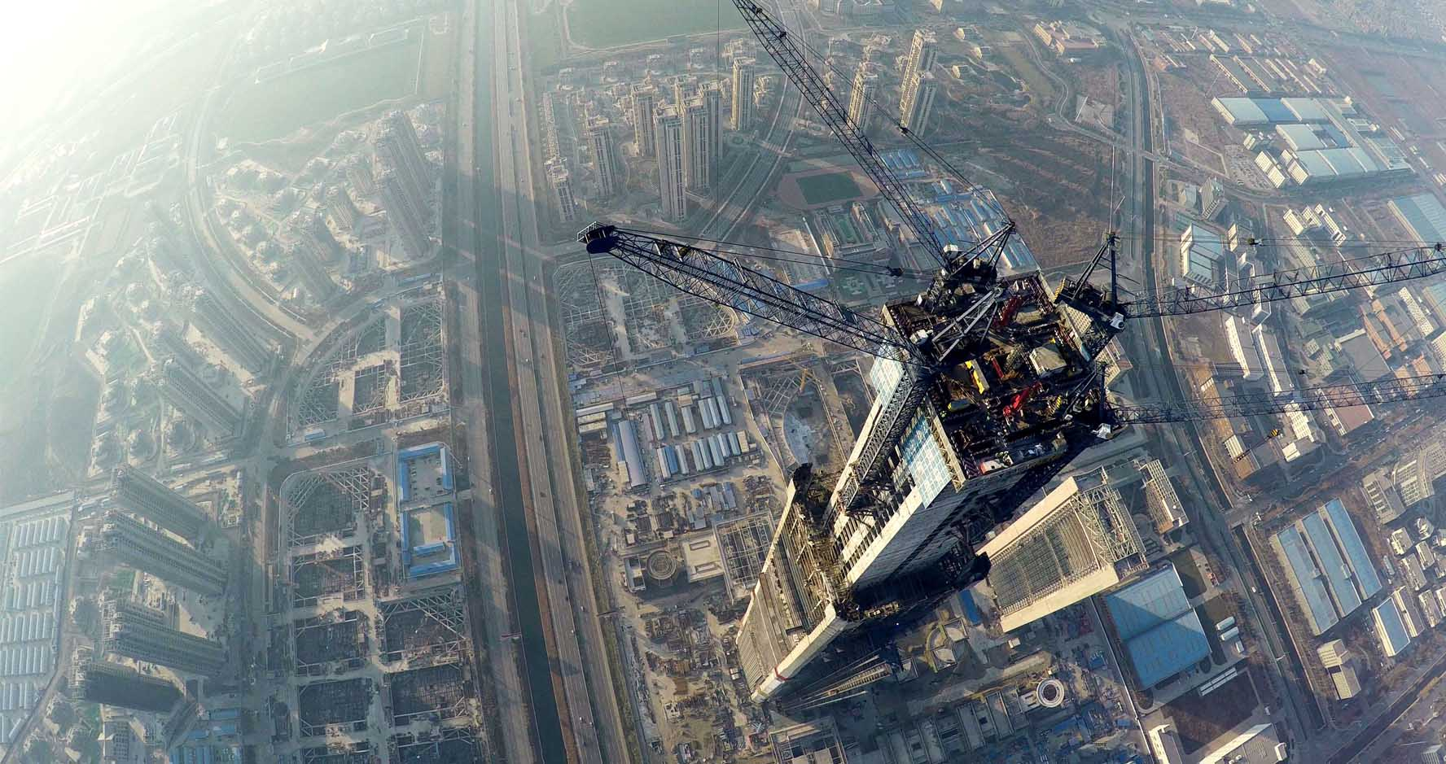
Internal causes
The construction industry and heavy industry
Control capital and time
Internal efficiency

Slide 6
External reason
Project Success
Time
Budget
Performance
Client Acceptance
As a measure of project success, the triple constraint are not comprehensive enough to evaluate the project. For example, if the final product of project cannot bring any benefit to the company that means project failure. Although this product meets the triple constraint

Slide 7
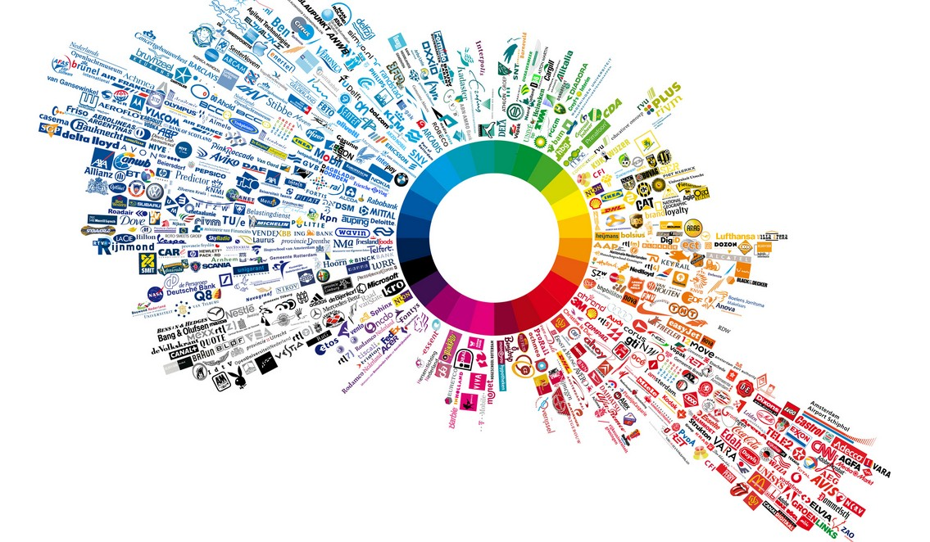
External reason
Focus on the customer satisfaction
The market is the final judge of the project
Bring customer great profits
The open atmosphere is very important in the development of project

Slide 8
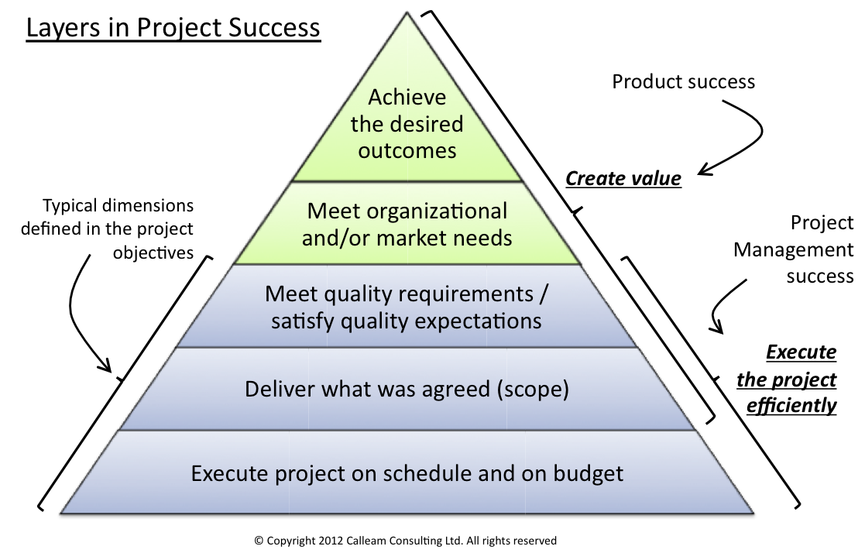
Layers in project success
Figure 1 Layers in project success click for larger image

Slide 9

What is Project Success
These different perspectives means that over time the project’s success or failure may changed. The Sydney Opera House is a good example.
In the 1957, The original project made a plan for that. The project should to be finished in 5 years at a cost of $7,000,000. In the end, the project cost $102,000,000 and took 13 years. By any measure that was filed project, and it was denounced by many media at the time.
In retrospect, now that we can look back many years later, it is clear that the project created something of enormous value.

Slide 10
Thanks for your attention

